Slide 1
English Stylistics
Week 15 Other Stylistic Features

Slide 2
In-class writing – a mini-text analysis
Reading and understanding
Summary – the topic, the characters, the theme
Interpretation – the analysis of specific details & techniques
Evaluation – the effect and your comment.
Academic style, around 300 words

Slide 3
Significant features
Short verbs of physical actions (dart, prick, blaze, dab)
Long and static nouns (measured grace, snoring sessions)
Parallel structures
Metaphor and simile (the London Club)
Contrast
Personification (to box, to dance)

Slide 4
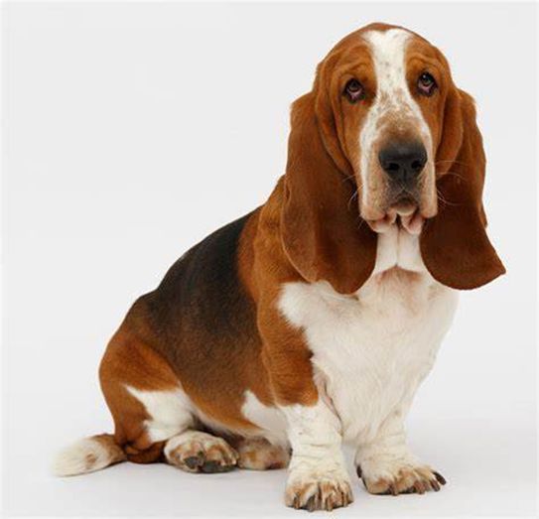
Well-written sentences
The composed and calm personality of the dogs are manifested through the static nouns.

Slide 5
Well-written sentences
Particularly in the fourth paragraph, after a string of long sentences about Bassets, the short one “And then came Buster” abruptly ends the whole paragraph, producing a strong sense of contrast. (… which makes a sharp transition from peace to chaos)

Slide 6
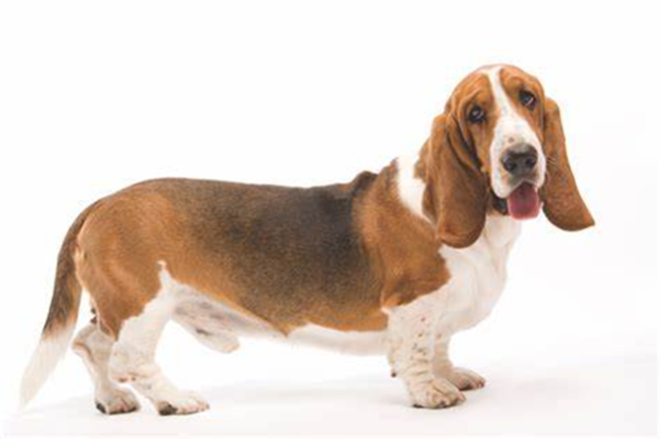
Well-written sentences
The two short sentences were foregrounded to show the abruptness of Buster’s arrival and the sorrow of the Bassets.

Slide 7
Well-written sentences
Phoneasthesia therefore comes into effect. For instance, “long snoring” and “unruffled” elongated the sounds, which creates and strengthens a sense of leisure, easiness and calmness.

Slide 8
Well-written sentences
The last sentence of the first paragraph, in fact, sets the tone of the whole text as the coming of Buster may replace the sorrow to a certain degree.

Slide 9
Well-written sentences
Buster’s arrival is likened to “the intrusion of an irreverent outsider into an exclusive London club”, which establishes Buster’s image as an uninvited stranger…

Slide 10
Suggestions for improvement
Variety (esp. “The author uses… to …”)
Consider the reader.
Analyze or explain the examples. (interpretation)
Avoid empty adjectives (fascinating, amazing, lovely, delightful, or even vivid)

Slide 11
Different styles: academic vs. creative writing
Academic | Creative
Expository (explain and define) | Creative fiction (imagine)
Descriptive (depict and describe) | Creative non-fiction (interpret)
Narrative (tell a story) | Autobiography (sharing experiences)
Persuasive (convince) | Biography (tell a story)
Argumentative (argue) | Derivative fiction (fan fiction)
Position paper (state your position) | Journal writing (make observations)

Slide 12
Different styles: academic vs. journalistic
Academic | Journalist
How? Why? | Who? What? When? Where?
Concepts | People
Processes | Places
Relationships | Events
Impersonal | Personal
Objective, scientific | Expressive, dramatic
Limited scope | Wide scope

Slide 13
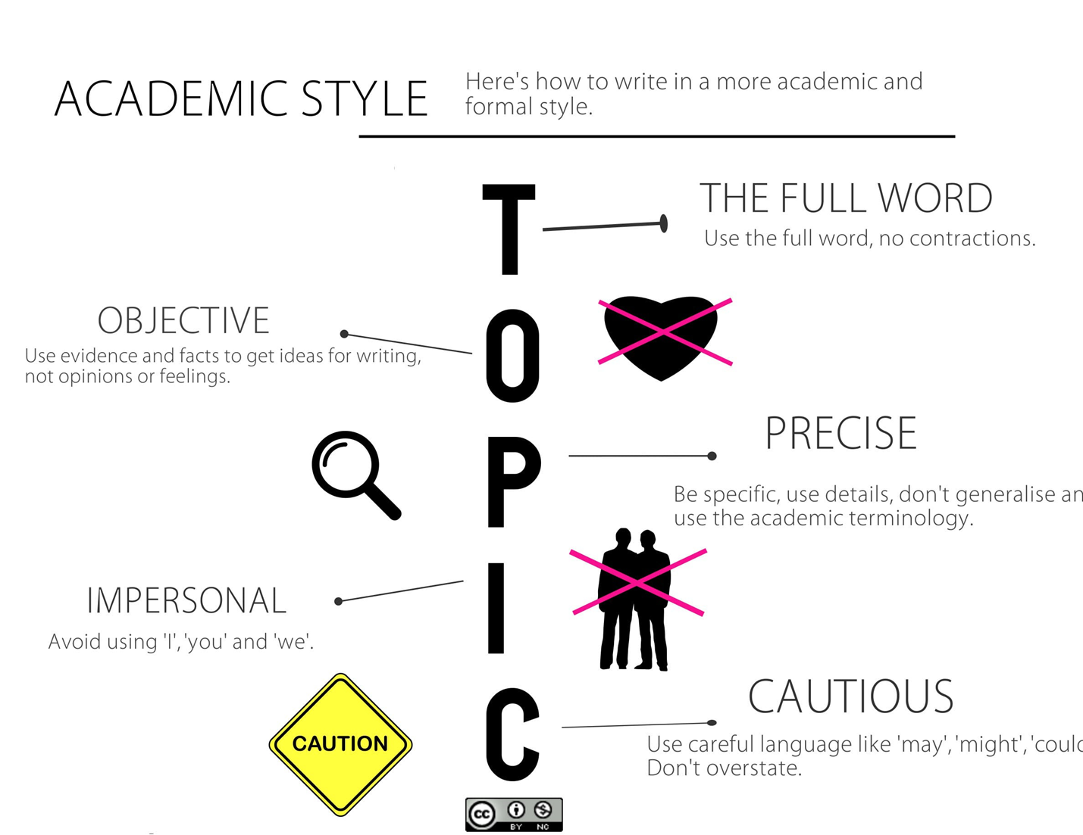

Slide 14
Stylistic deviation
Repetition (even redundancy)
Ambiguity
Multimodality (visual, audio or other modes)
Non-standard varieties (语言变体)

Slide 15
“Cooperative Principe” in communication
Maxim of Quantity
Maxim of Quality
Maxim of Relation
Maxim of Manner

Slide 16
Repetition: from Sinclair Lewis, Babbitt
“All about him the city was hustling, for hustling’s sake. Men in motors were hustling to pass one another in the hustling traffic. Men were hustling to watch trolleys, with another trolley a minute behind, and to leap from the trolleys, to gallop across the sidewalk, to hurl themselves into buildings, into hustling express elevators. …”

Slide 17
Ambiguity: from Hemingway, Hills Like White Elephants
"You've got to realize," he said, "that I don't want you to do it if you don't want to. I'm perfectly willing to go through with it if it means anything to you."
"Doesn't it mean anything to you? We could get along."
"Of course it does. But I don't want anybody but you. I don't want anyone else. And I know perfectly simple."

Slide 18
Ernest Hemingway, Hills Like White Elephants
"Yes, you know it's perfectly simple."
"It's all right for you to say that, but I do know it."
"Would you do something for me now?"
"I'd do anything for you."
"Would you please please please please please please please stop talking?"

Slide 19
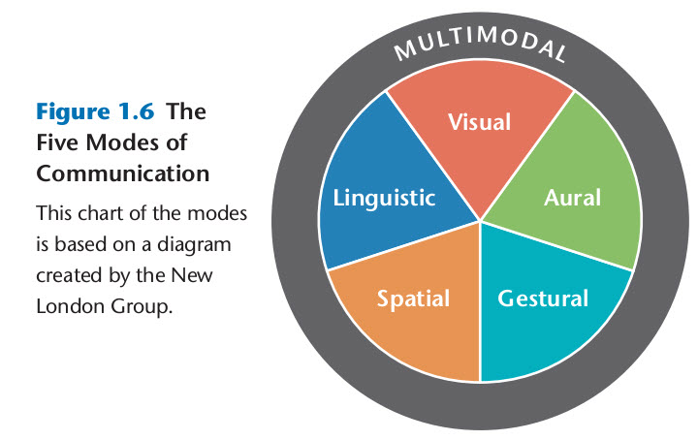
Multimodality

Slide 20
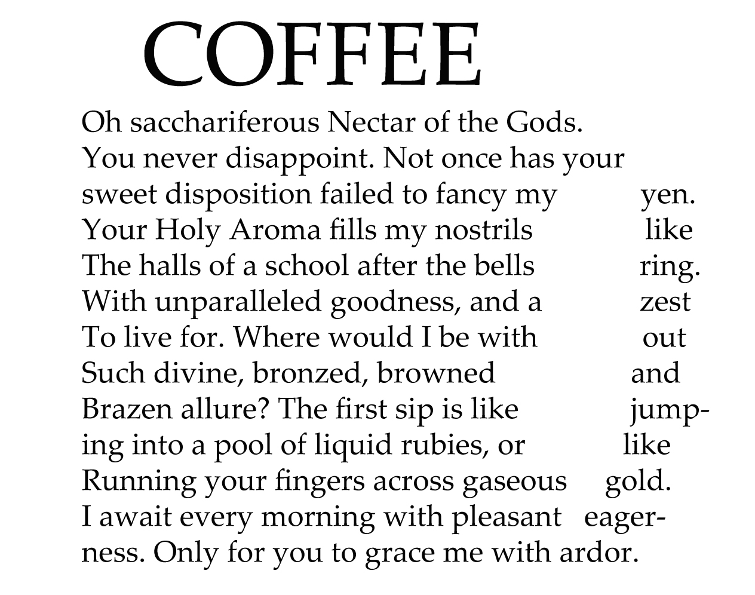

Slide 21
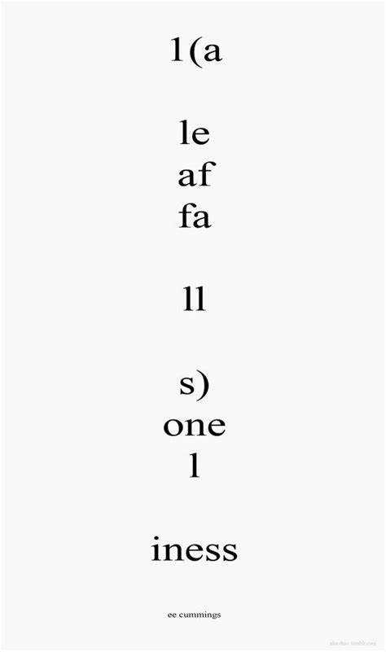
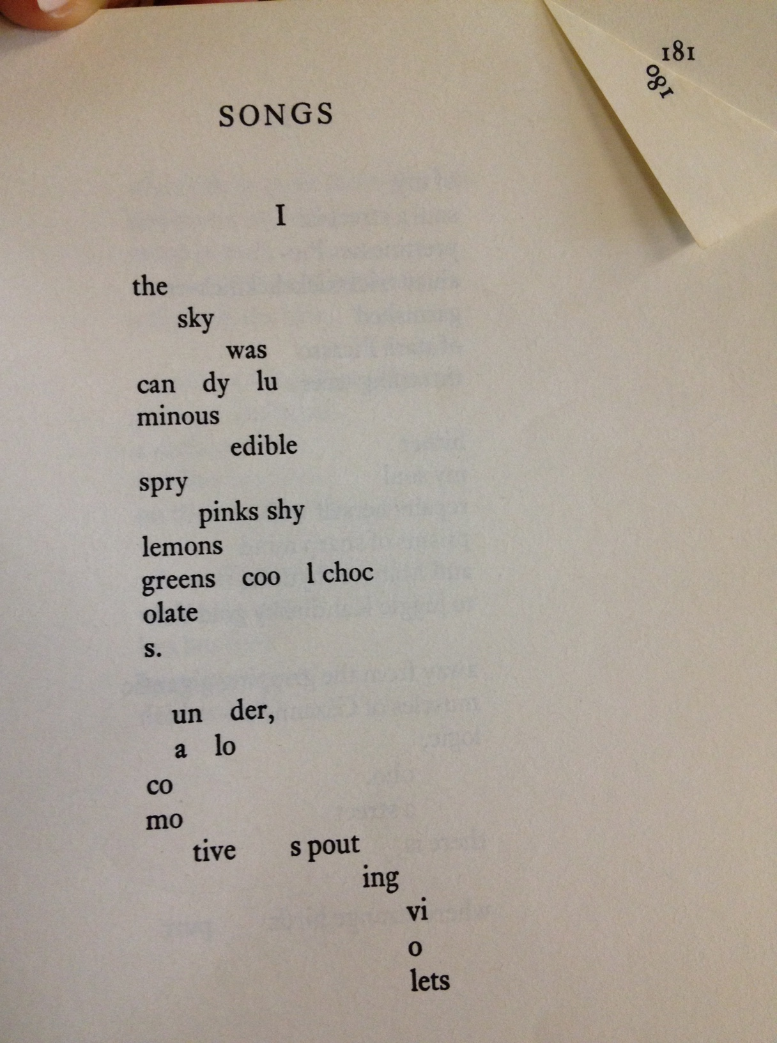
Visual poems

Slide 22
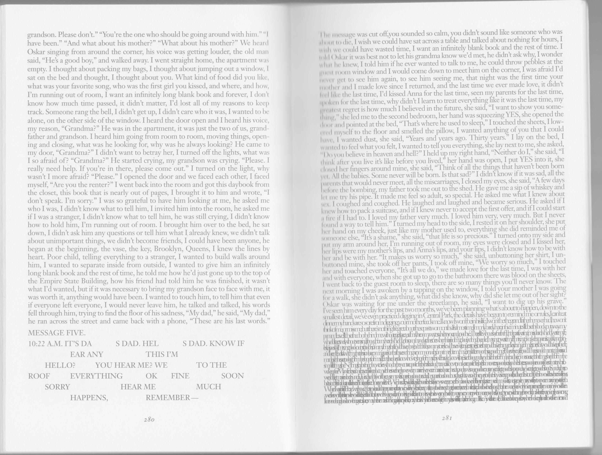

Slide 23
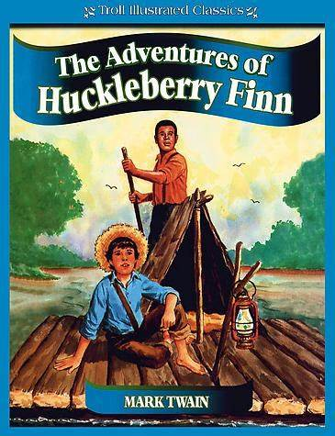
Non-standard English: dialect
Jim sings out: “We’s safe, Huck, we’s safe! Jump up and crack yo’heels, dat’s de good ole Cairo at las’, I jis knows it!” “I’ll take the canoe and go see, Jim. It mightn’t be, you know.”

Slide 24
Examples in Chinese
“嗡嗡的一阵乱嚷，蚊子都撞过赤膊身子，闯到乌桕树下去做市。” (鲁迅《风波》
汪小姐说，有一种女人，开口就谈情调，谈巴黎，谈吃茶，谈人生，这是十三点。开口闭口谈小囡，奶瓶，尿布，打预防针，标准十三点。一开口，就是老公长，老公短，这是妖怪。” （金宇澄《繁花》）

Slide 25
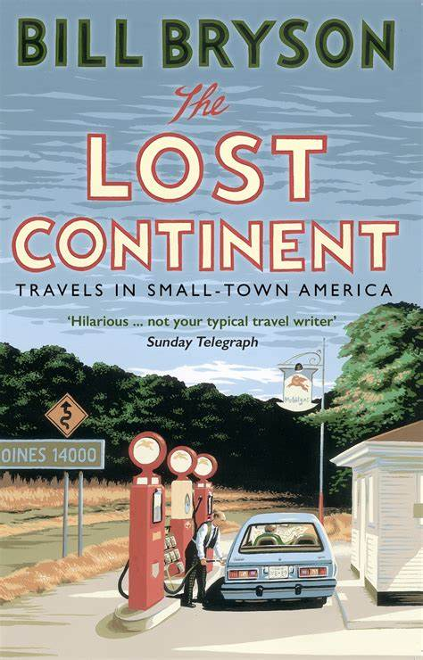
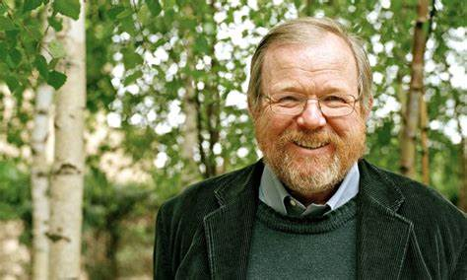
In-class reading: Text 33

Slide 26
Final paper requirements
Title
Word count
Gunning-fog index of readability

